Slide 1
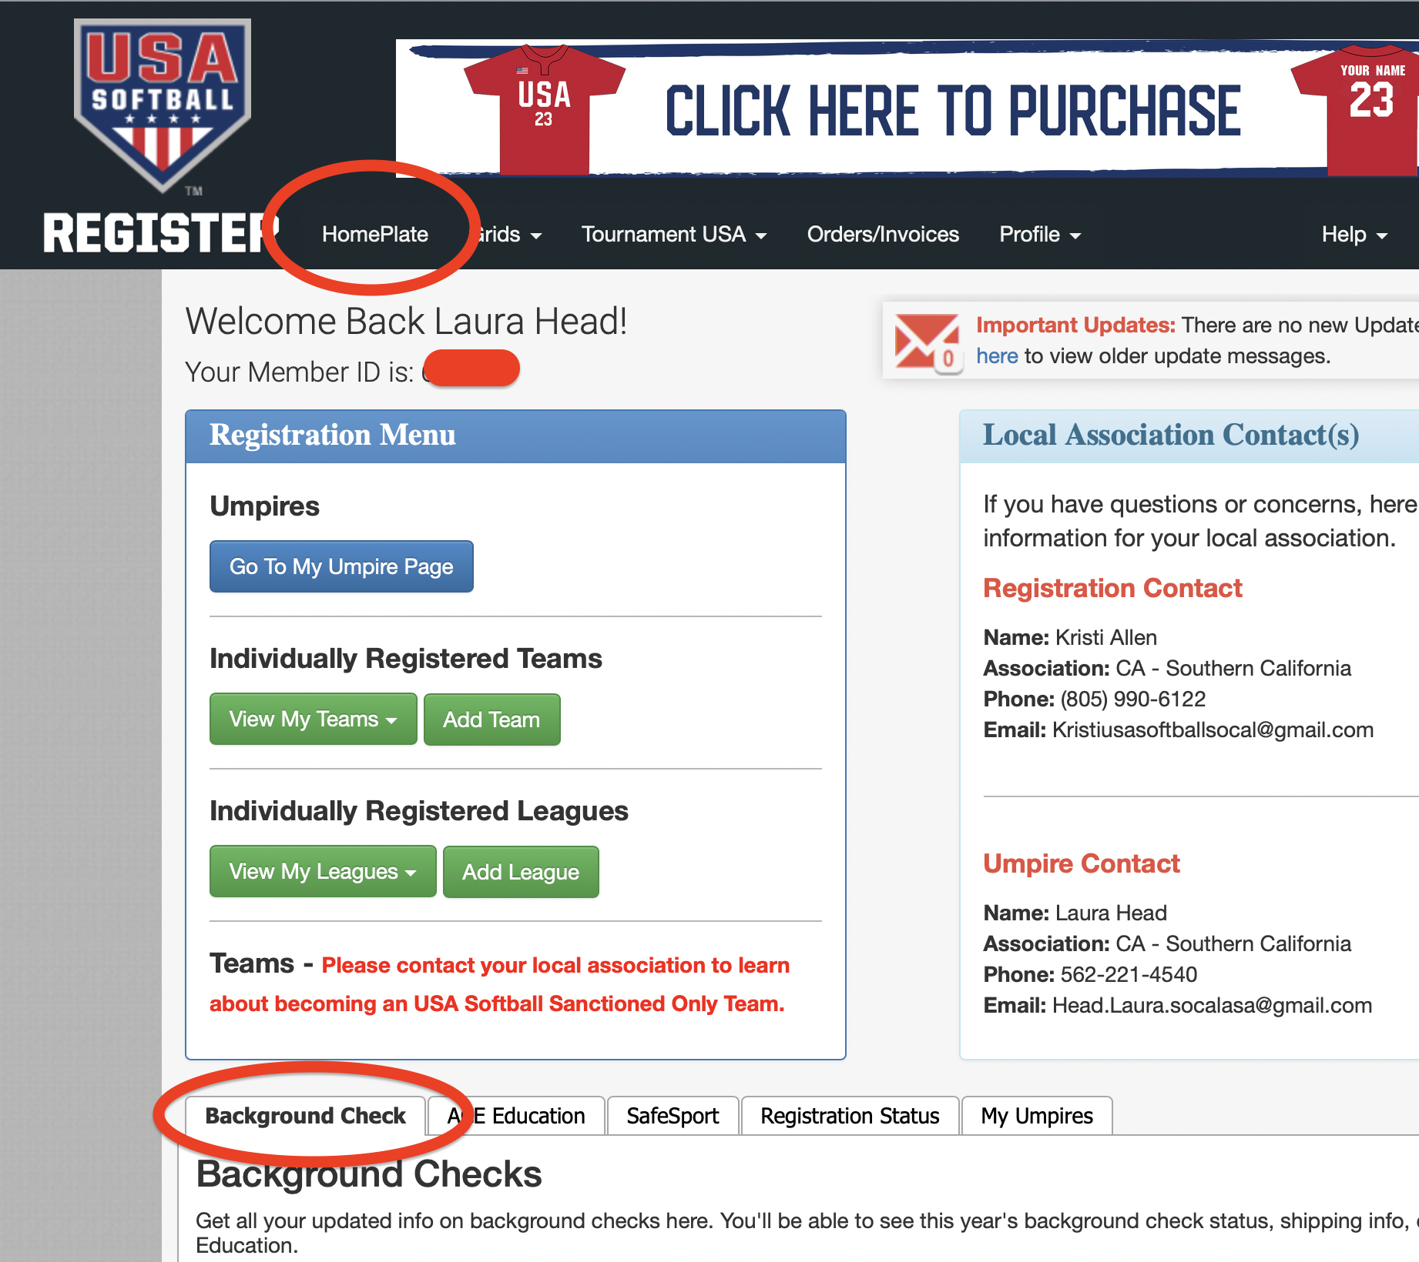
How To . . . Activate
Background Check
Go to your HOME PLATE (circled in Red) –
Click on the tab – Background Check (circled in Red)

Slide 2
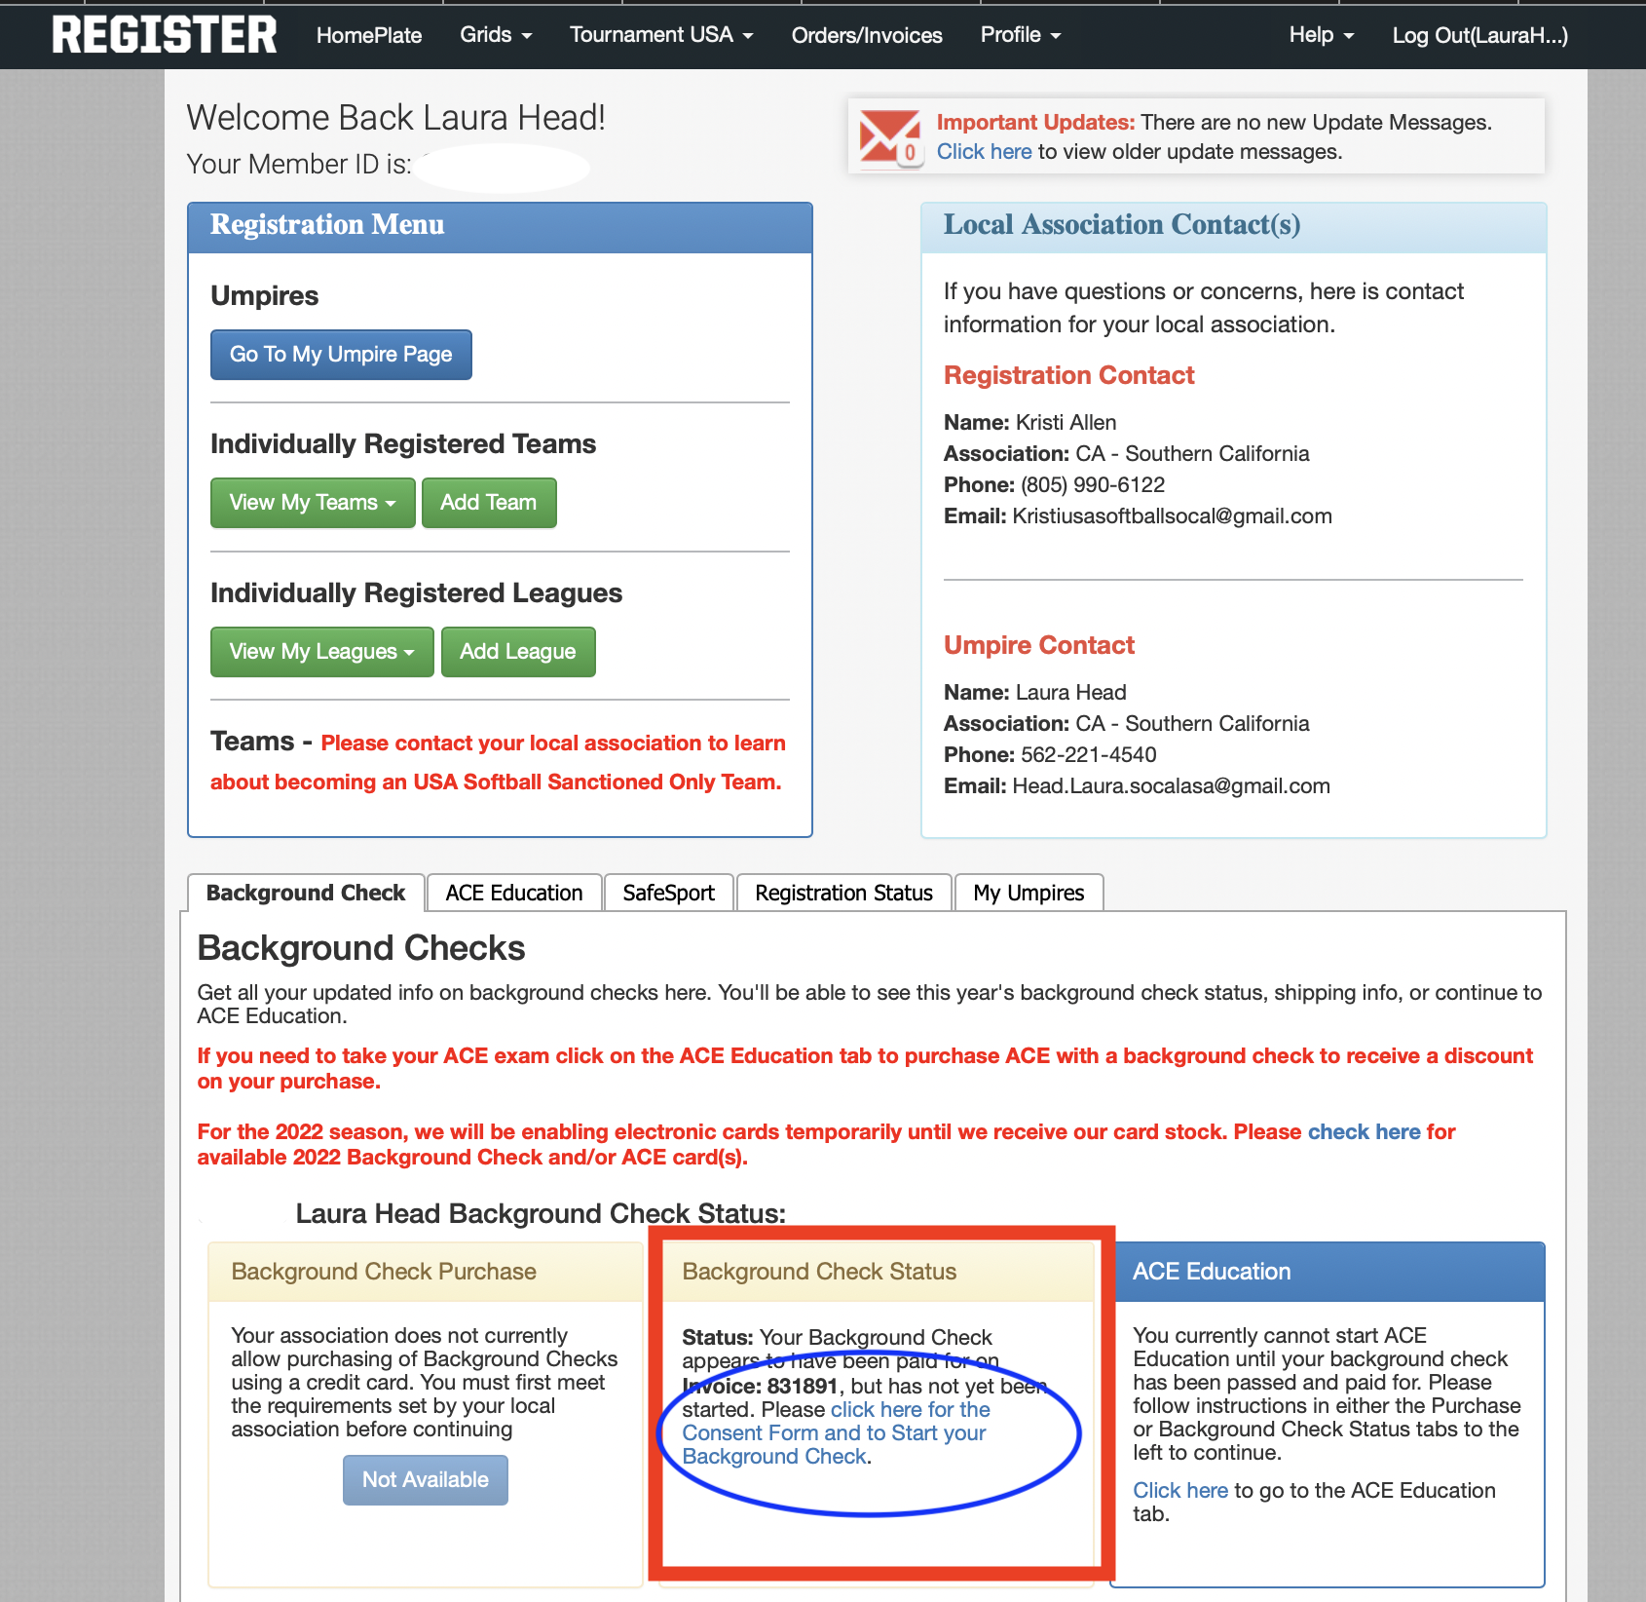
How To . . . Activate
Background Check
Click on the Blue wording stating “click here for the Consent Form and to Start your Background Check” (circled in Blue) in the box labeled Background Check Status (boxed in Red).

Slide 3
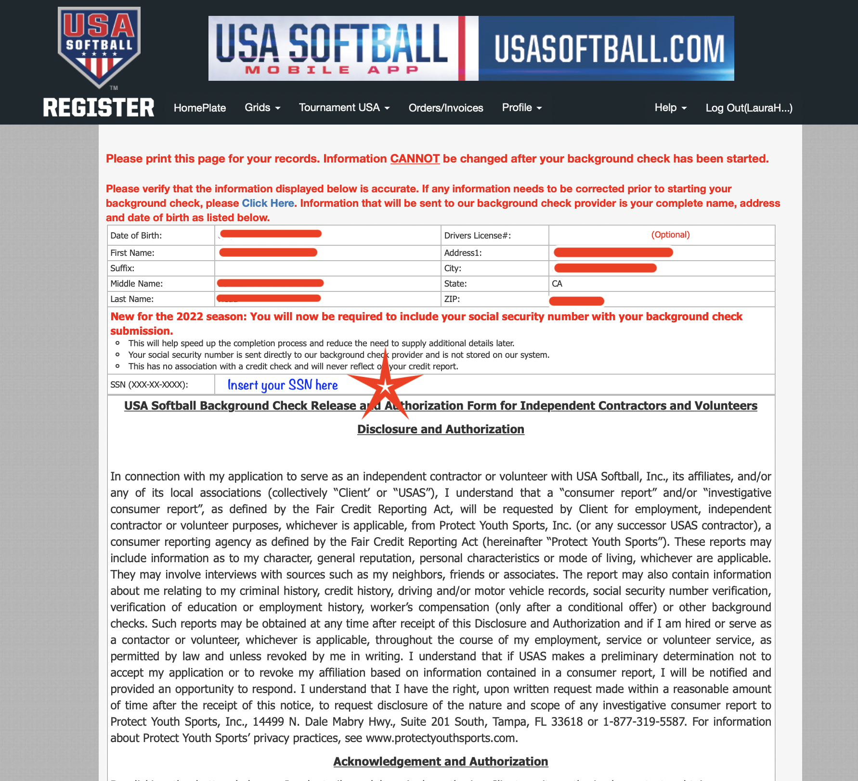
How To . . . Activate
Background Check
Insert your social security number (Starred in Red)

Slide 4
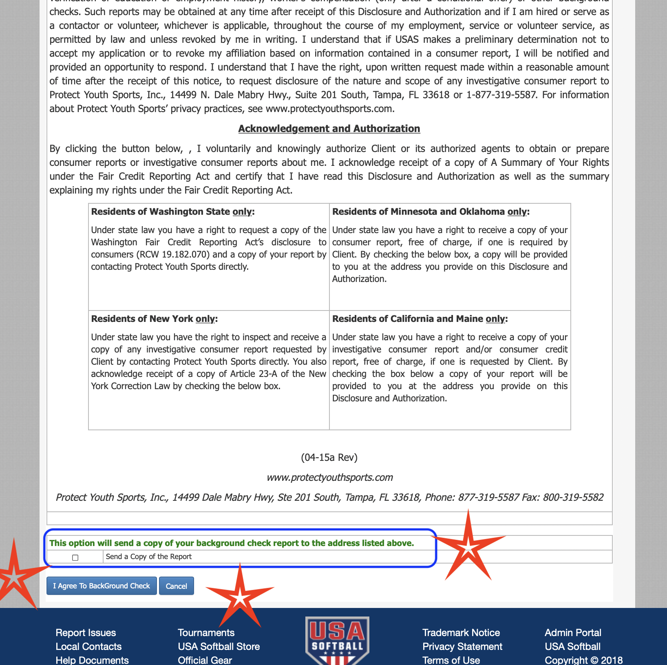
How To . . . Activate
Background Check
After entering your SSN, scroll to the bottom
Check the box if you want a copy of your background check (boxed in Blue)
Click to Agree to the background check (near Red Stars)

Slide 5
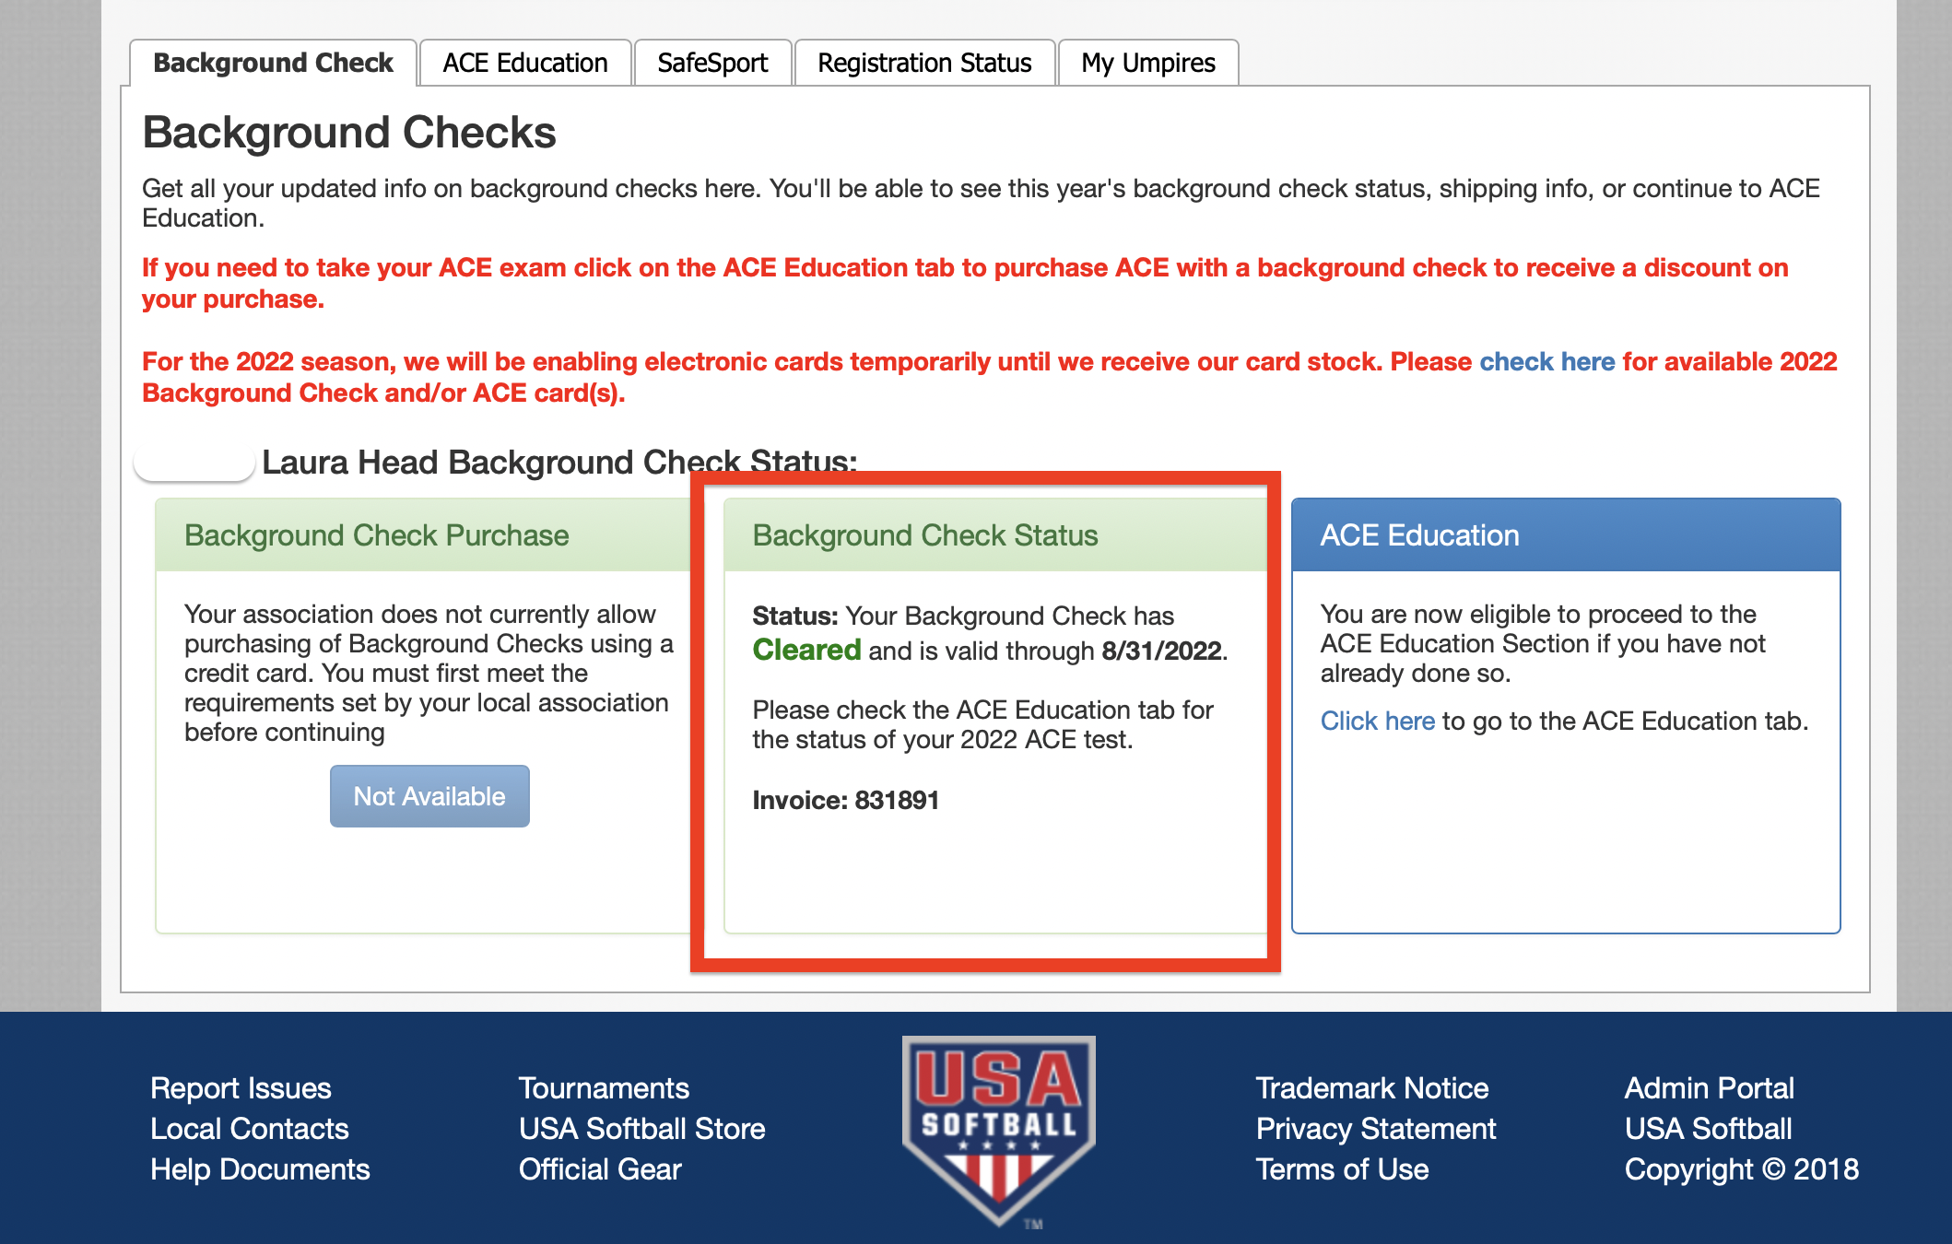
How To . . . Activate
Background Check
Your background check should clear shortly
Return to the HOME PLATE
Under the Background Check tab, the Background Check Status box should be updated momentarily.

